Slide 1

LINEAR REGRESSION

Slide 2




LINEAR REGRESSION WITH A STORY
Ravi decides to start tracking how many hours he studies each day and what marks he scores
Days
Hours Studied
Marks scored
1
1
35
If I study for 6 hours tomorrow, can I predict how
many marks I might score?
2
2
40
3
3
45
60 55
50 45
40
35
So, what does linear regression do? It finds the best-fitting straight line through
4
4
50
Ravi’s data points. That line might look like:
5
5
55
Marks=5×Hours+30
1
2
3
4
5
6
This means:
For every extra hour studied, marks increase by 5. Even if he studies 0 hours, he might still get 30 marks (maybe from class performance!).

Slide 3
LINEAR REGRESSION WITH A STORY
So, how many marks for 6 hours?
Marks=5×6+30=60
Ravi now has a prediction model. That’s Linear Regression in action.
Real World Summary:
Linear Regression is like drawing a smart line through known data, so you can predict the future

Slide 4

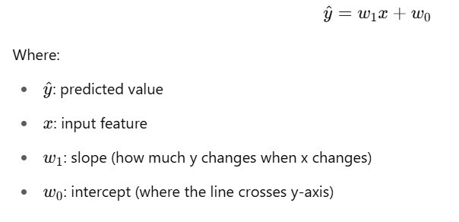
What is Linear Regression?
Linear Regression is one ofthe simplest and most widely used algorithms
in Machine Learning and Statistics. It helps us find the relationship between a dependent variable (target) and one or more independent variables (features) using a straight line.
Basic Equation:

Slide 5
Goal of Linear Regression:
Tominimizethe error betweenpredicted values and actual values using a cost function like
Mean Squared Error (MSE).
When to Use Linear Regression
There is a linear relationship between variables (data forms a trend) You are predicting a continuous output (not categories) You need a simple, fast model that is interpretable
When Not to Use Linear Regression?
If the relationship between X and Y is not linear If there is high multicollinearity between features If you are working with categorical outputs (use classification instead)

Slide 6

Real time use cases
Use Case
Domain
Predict house prices based on size, location,
etc.
Predict student scores based on hours
studied
🏠
Real Estate
📚
Education
🛒
Predict sales based on ad budget
Business
Estimate employee salary based on
experience
Predict patient recovery time based on age,
condition
Predict stock prices based on previous
trends
💼
HR Analytics
💊
Healthcare
📈
Stock Market

Slide 7
Q1. What is the main objective of Linear Regression in Machine Learning?
A) To classify data into categories
B) To reduce dimensionality
C) To fit a line that minimizes the difference between actual and predicted values D) To find clusters in data
Q2. In the equation y = w1(x) + w0 , what does w1 represent?
The y-intercept
B) The slope of the line
C) The error term
D) The predicted output
Q3. Which of the following is used to measure the error in Linear Regression? A) Confusion Matrix
B) Mean Squared Error (MSE)
C) Entropy
D) Accuracy Score

